Slide 1

Temperature Monitoring using LoRA
DAY 19
EMBEDDED SYSTEM DESIGN & IoT-Master Class

Slide 2
What You will learn Today?
Temperature Monitoring using LoRA
Hardware Required
Software Required
what is LoRa & LoRAWAN
Hos DHT11 Works
Demo

Slide 3
Mindset Lesson for the Day
Don’t Blame on Circumstances, Look for the circumstances you want ,if you cann’t find them Make them

Slide 4
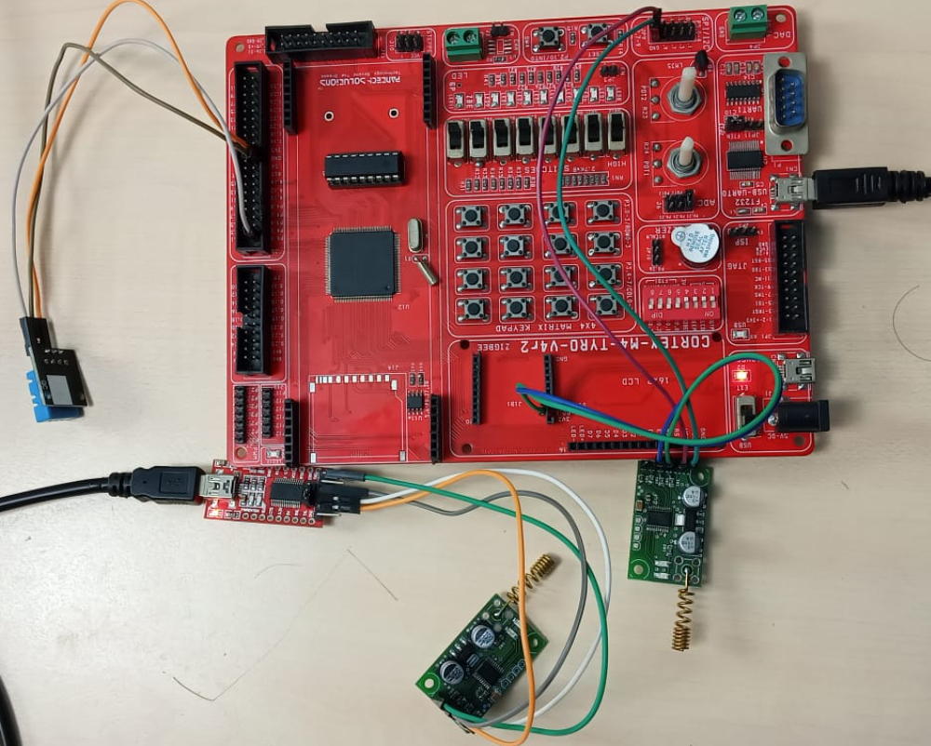
Temperature Monitoring using LoRA

Slide 5
Hardware Details
ARM CORTEX M4 LPC4088 Board
LORA MODULE-
DHT11
FT232H Module

Slide 6
Software Details
Keil
Hyperterminal
Flash Magic (Programming)

Slide 7
Features of LoRA
RF center frequency of 868MHz
Small 22mm x 36mm x 3mm form factor. Can fit into almost anything.
Standard UART interface with hardware flow-control (Clear-to-Send CTS) for long data packet handling
Easy to integrate into current devices that support RS-485, RS-232, RS-422 or 3.3V TTL serial data
Compatible to 5V power-supply and interface.
+20 dBm - 100 mW constant RF output vs. V supply.
Listen-before-talk and random back-off algorithm
16bit node address and 16bit network address
Acknowledgement based point-to-point communication with data hopping over repeaters
Settable channels, baud-rate, air-data rate and RF transmit power
Configurable parameters, signal-strength limit, ack timeout, network and point address
Up to 2Kilometers outdoor open air node-to-node range

Slide 8
Pinout of LoRA
GND
VCC 5V DC
CTS- clear to send module output
TXD - module input
RXD - module output
PROG

Slide 9
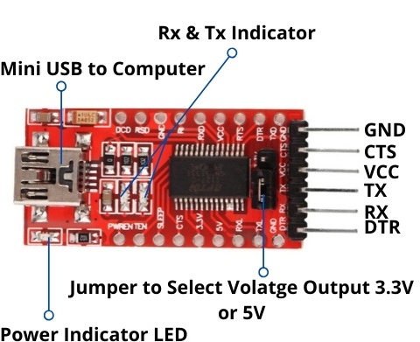
Pinout of FT232

Slide 10
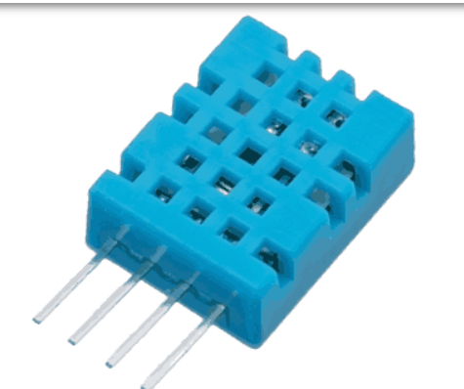
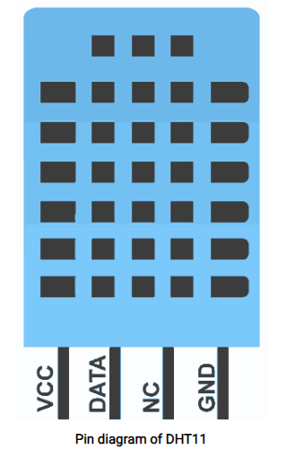
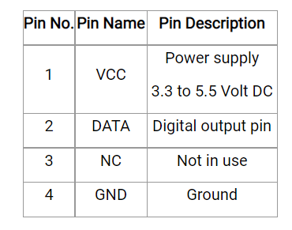
What is DHT11
DHT11 is a single wire digital humidity and temperature sensor, which provides humidity and temperature values serially.
It can measure relative humidity in percentage (20 to 90% RH) and temperature in degree Celsius in the range of 0 to 50°C.
It has 4 pins of which 2 pins are used for supply, 1 is not used and the last one is used for data.

Slide 11
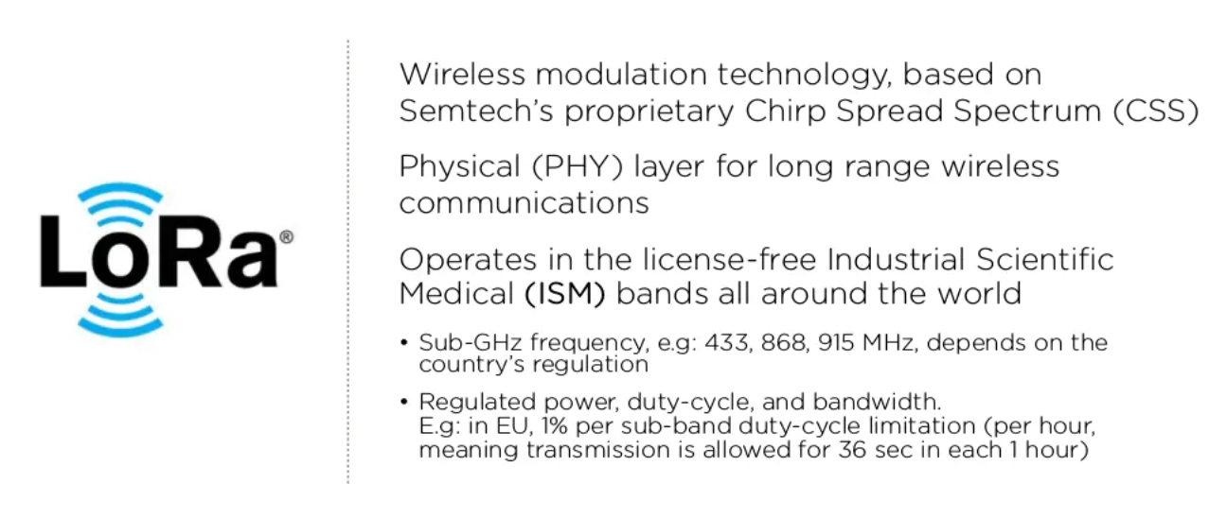
What is LORA

Slide 12
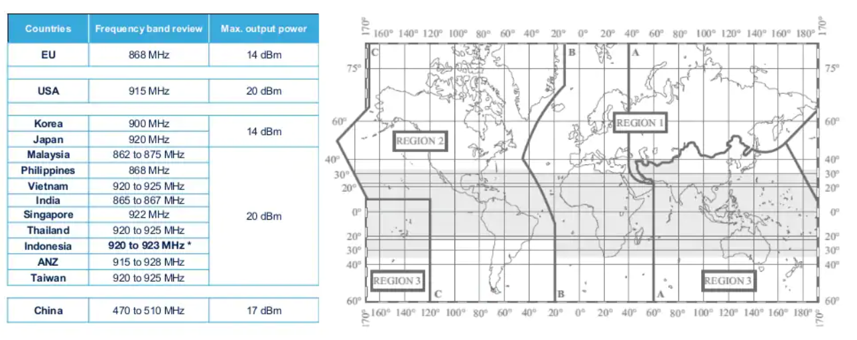
LORA Frequency Bands

Slide 13
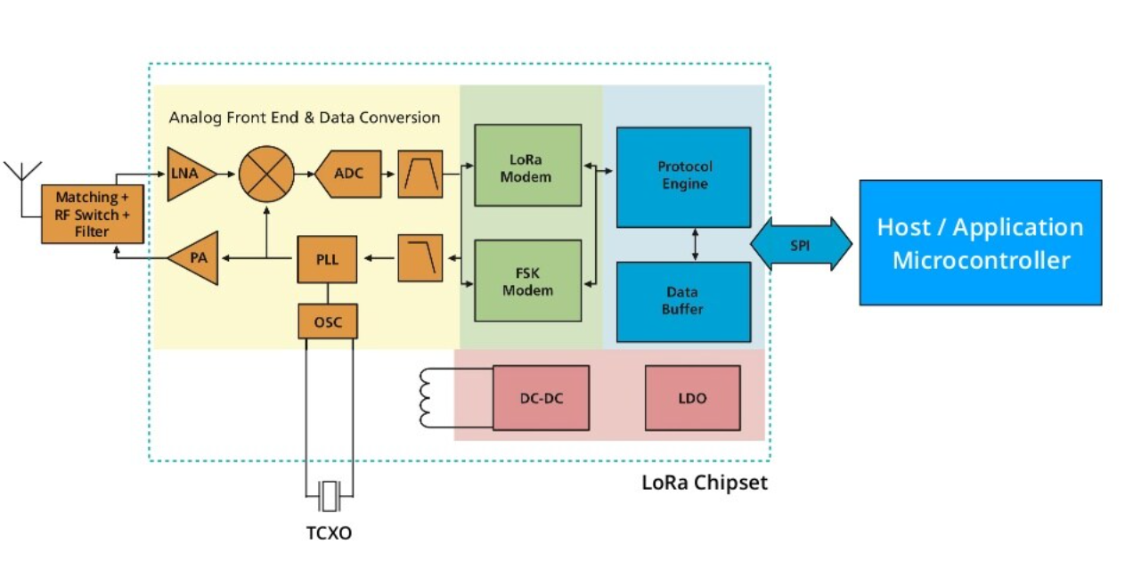
LoRA End Device/Node

Slide 14
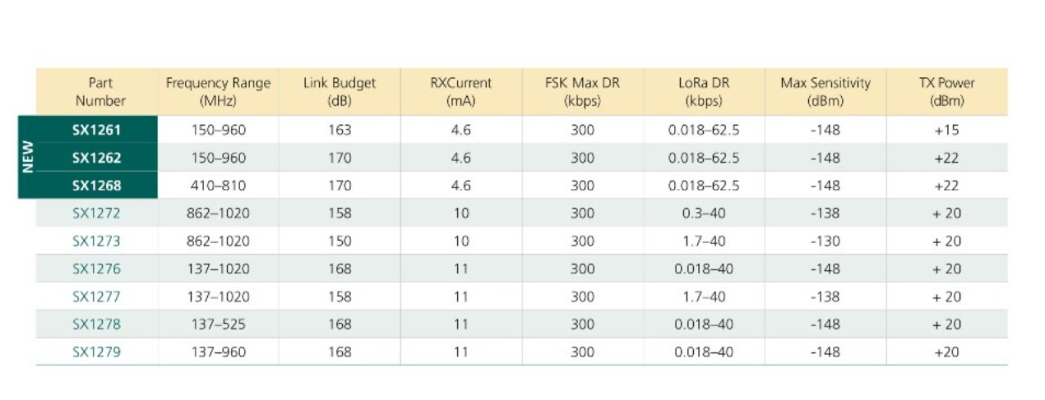
LoRA Chipset

Slide 15
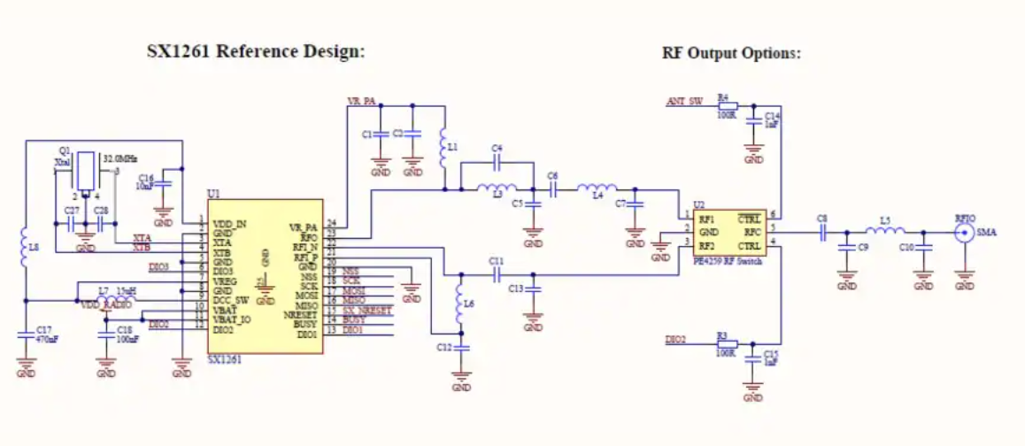
Lora Chipset : How to use it

Slide 16
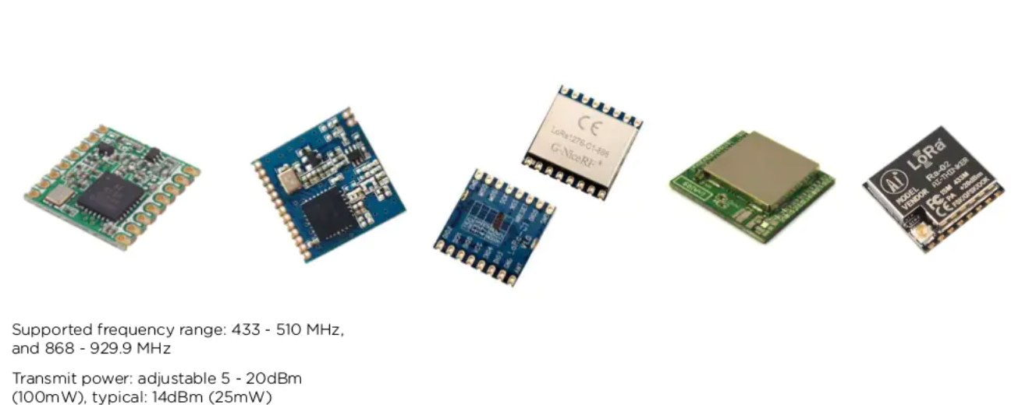
LoRa Modules

Slide 17
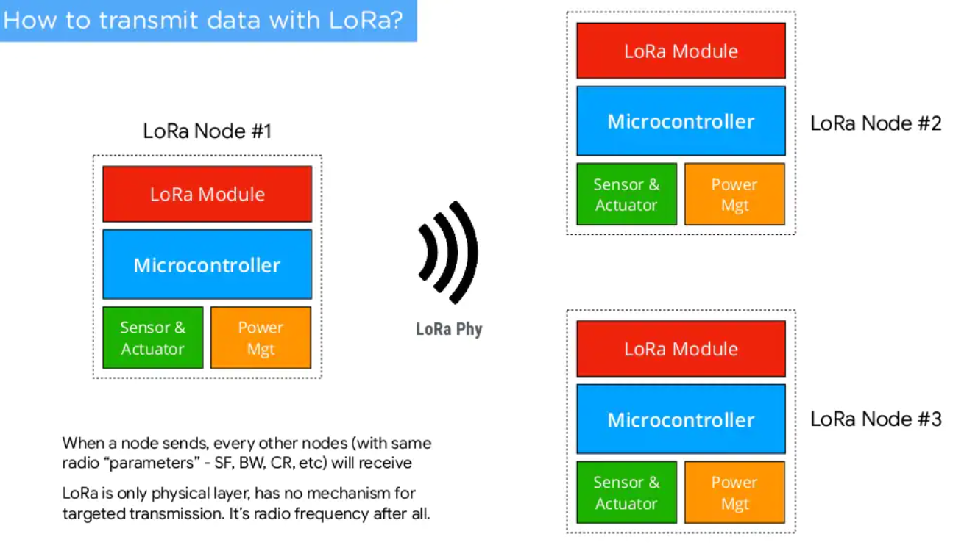
How to Transmit data

Slide 18
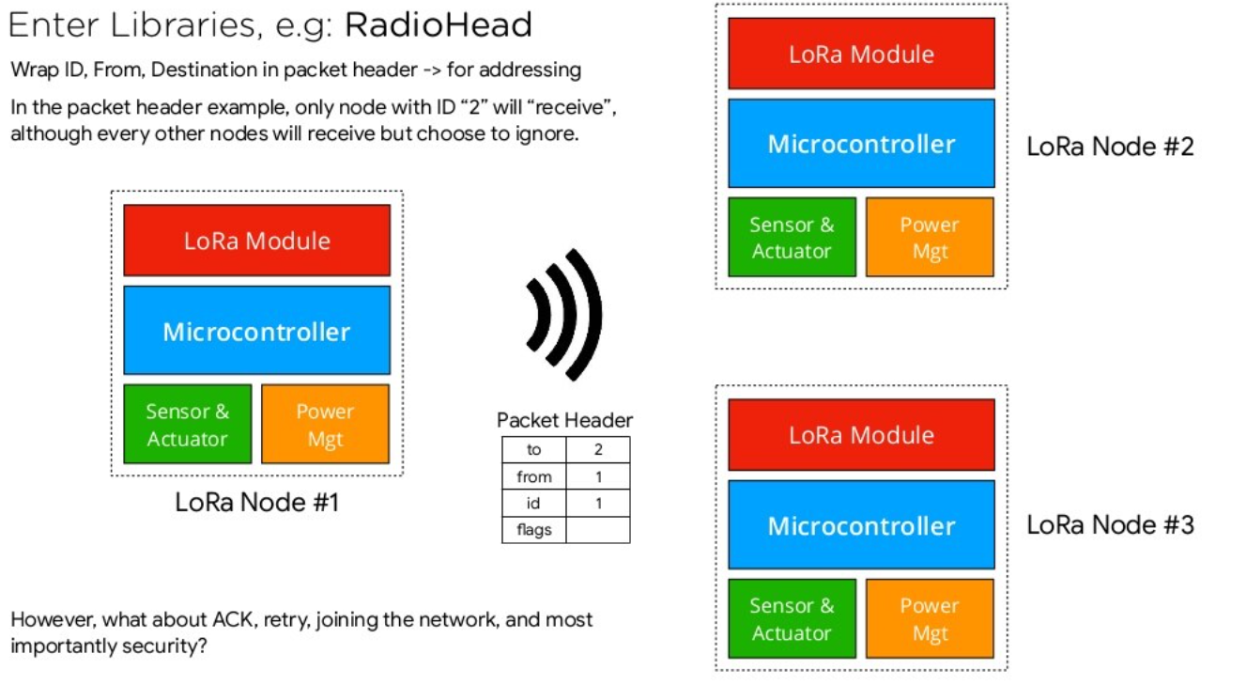

Slide 19
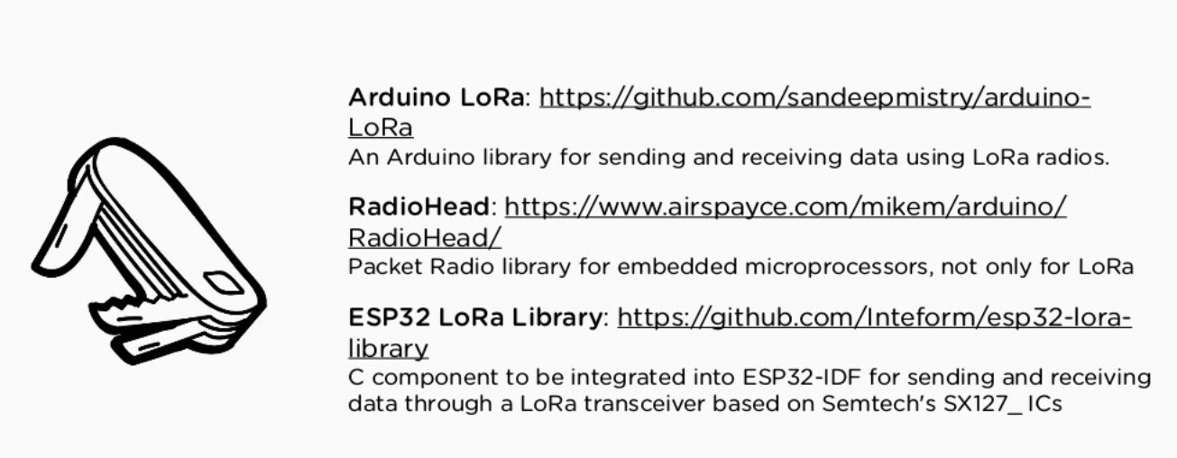
Lora Programming Libraries for Microcontroller

Slide 20
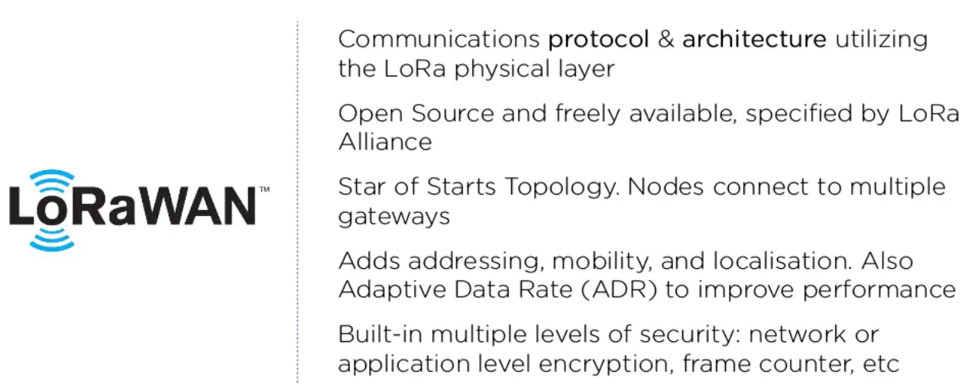
LoRaWAN : What is it?

Slide 21
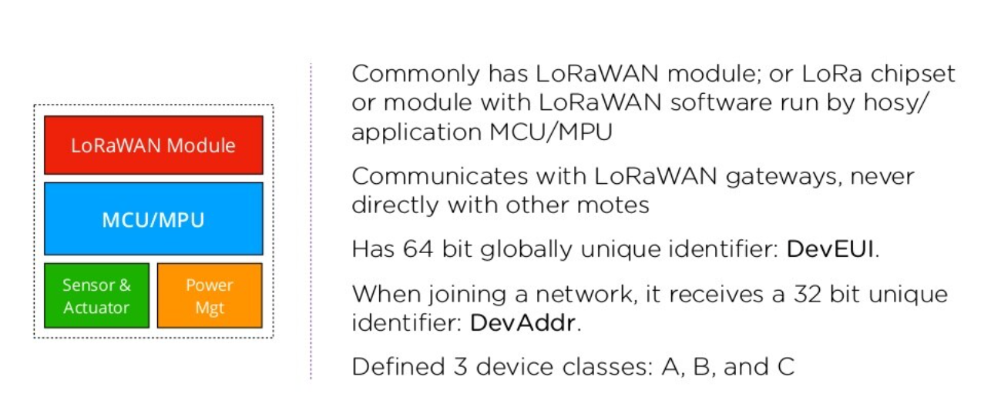
LoRa WAN End Device/Mote

Slide 22
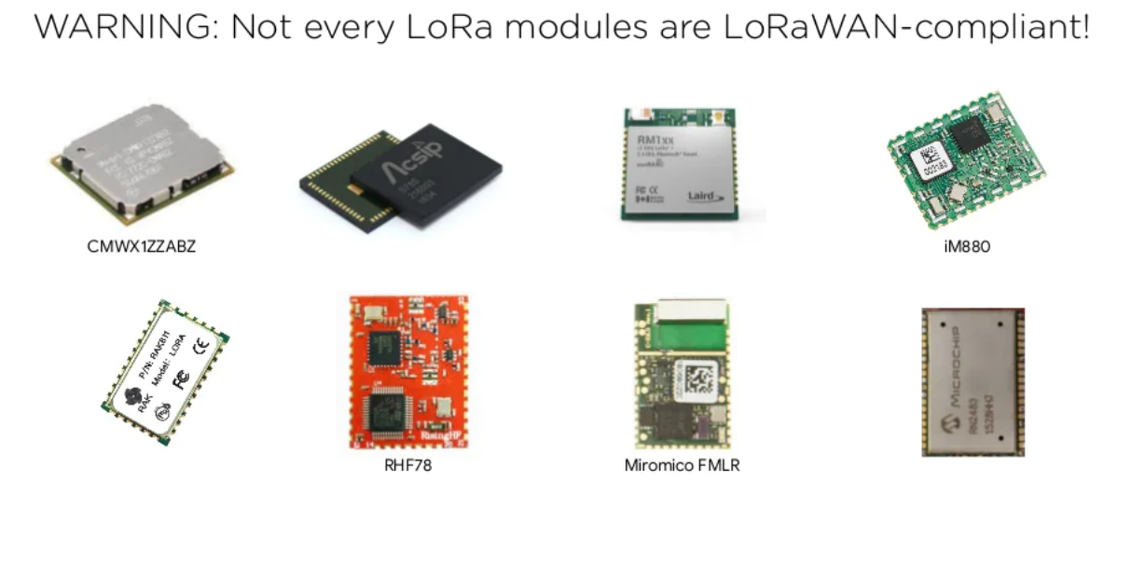
LoRaWAN Modules

Slide 23
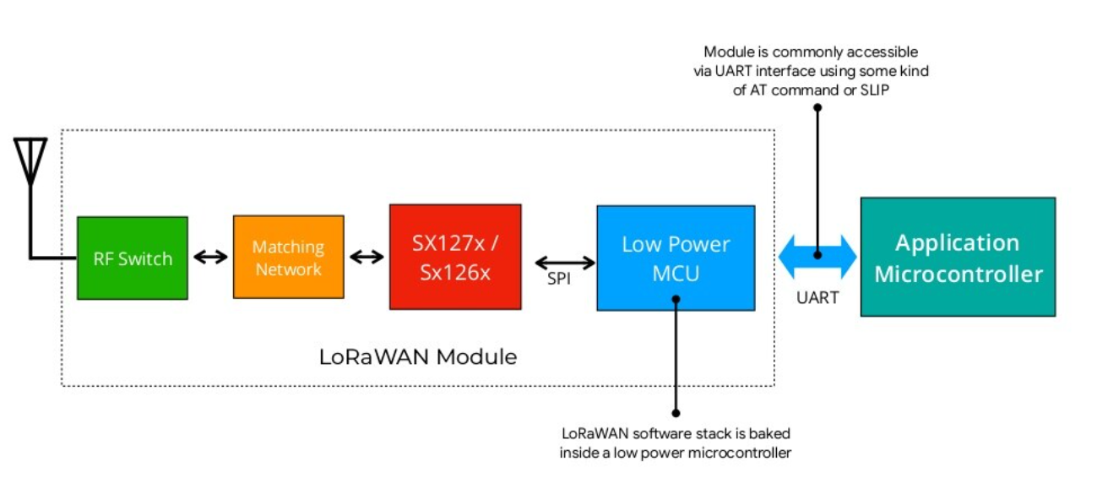
LoRa WAN Module:Common Architecture

Slide 24
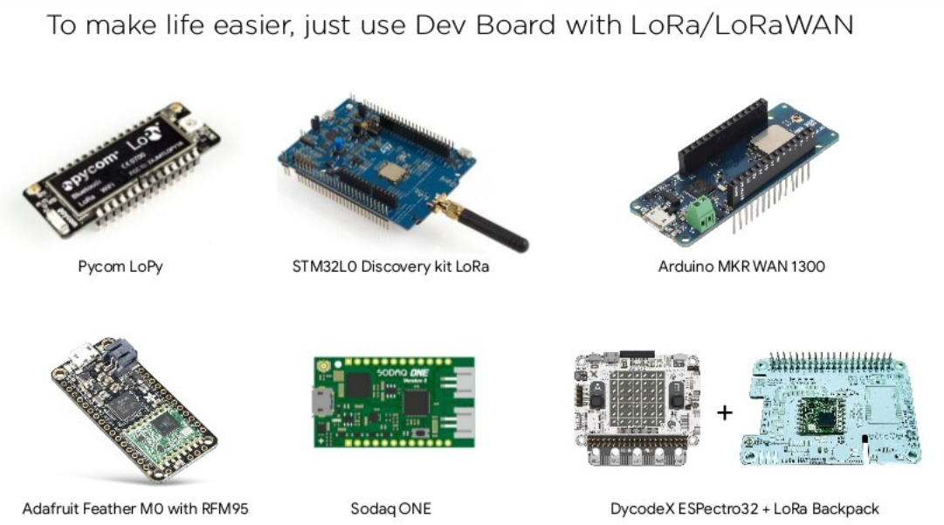
LoRA/LoRAWAN Dev Board

Slide 25
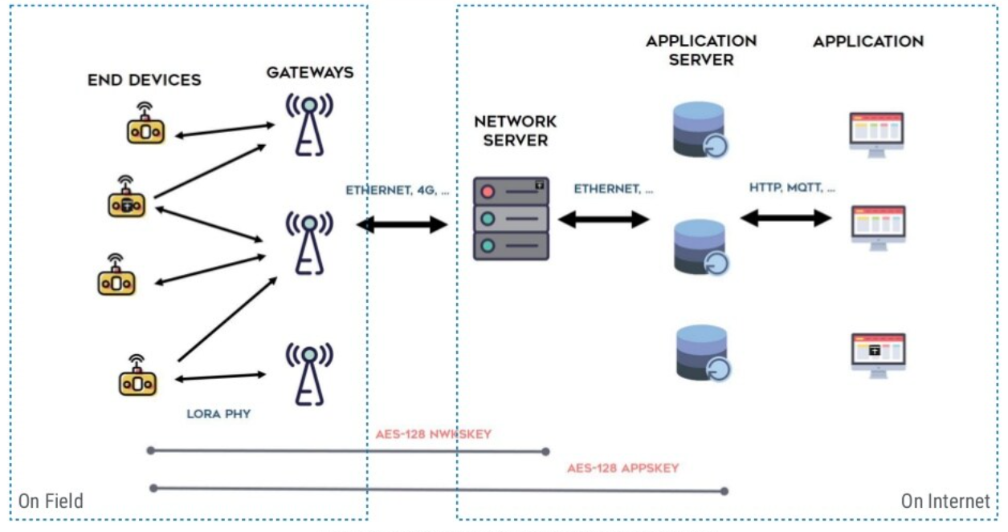
LoRaWAN Network: Common Architecture

Slide 26
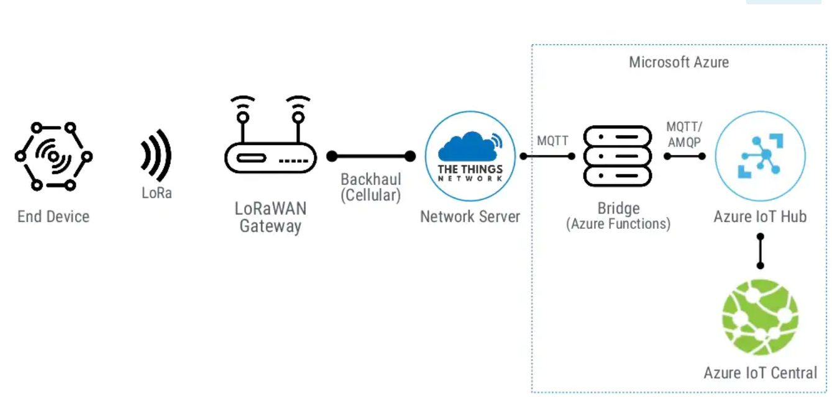
LoRaWAN Network: Sample Architecture

Slide 27
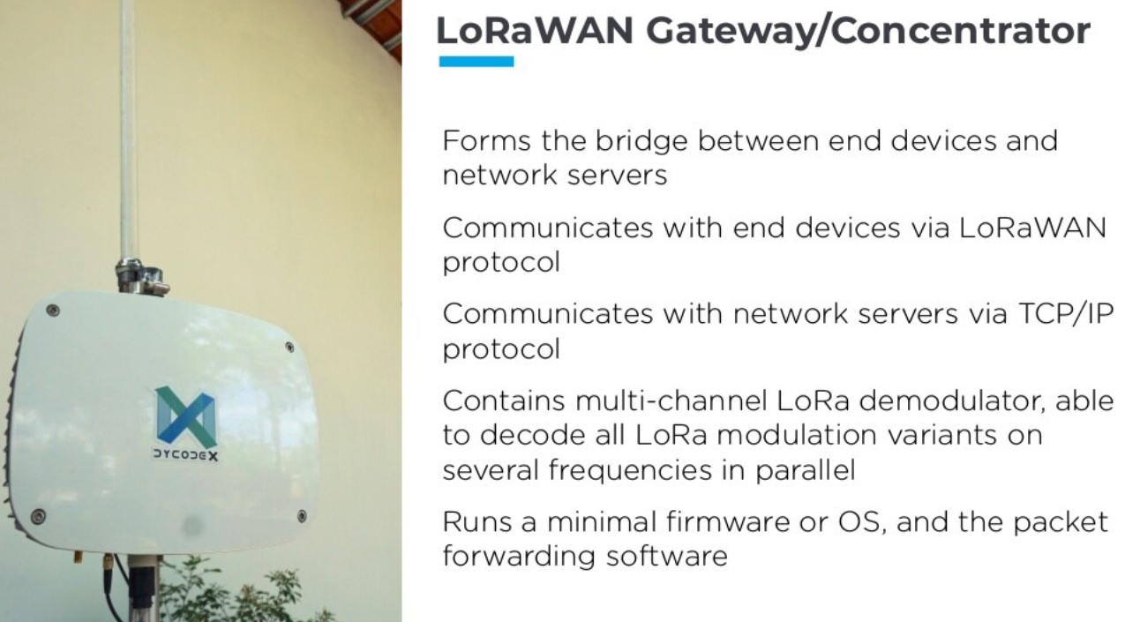
LoRaWAN Gateway/Concentrator

Slide 28
What is DHT11
DHT11 is a single wire digital humidity and temperature sensor, which provides humidity and temperature values serially.
It can measure relative humidity in percentage (20 to 90% RH) and temperature in degree Celsius in the range of 0 to 50°C.
It has 4 pins of which 2 pins are used for supply, 1 is not used and the last one is used for data.

Slide 29
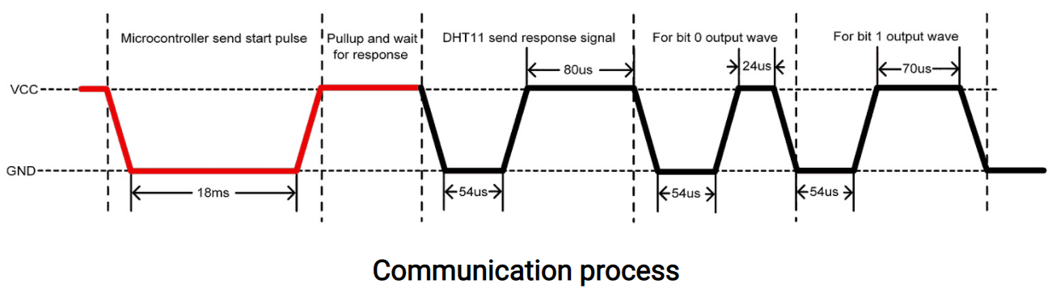
Communication with Microcontroller
DHT11 uses only one wire for communication. The voltage levels with certain time value defines the logic one or logic zero on this pin.
The communication process is divided in three steps, first is to send request to DHT11 sensor then sensor will send response pulse and then it starts sending data of total 40 bits to the microcontroller.

Slide 30
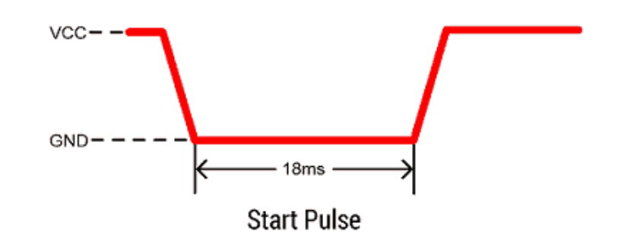
Start pulse (Request)
To start communication with DHT11, first we should send the start pulse to the DHT11 sensor.
To provide start pulse, pull down (low) the data pin minimum 18ms and then pull up, as shown in diag.

Slide 31
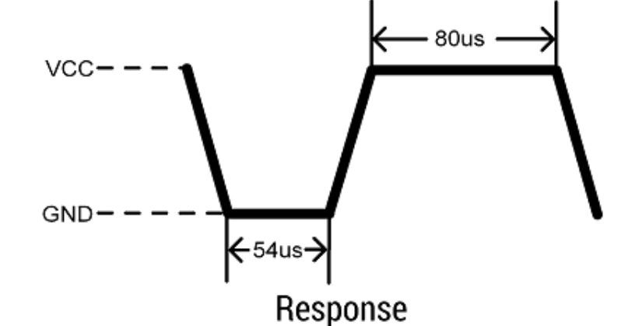
Response
After getting start pulse from, DHT11 sensor sends the response pulse which indicates that DHT11 received start pulse.
The response pulse is low for 54us and then goes high for 80us.

Slide 32
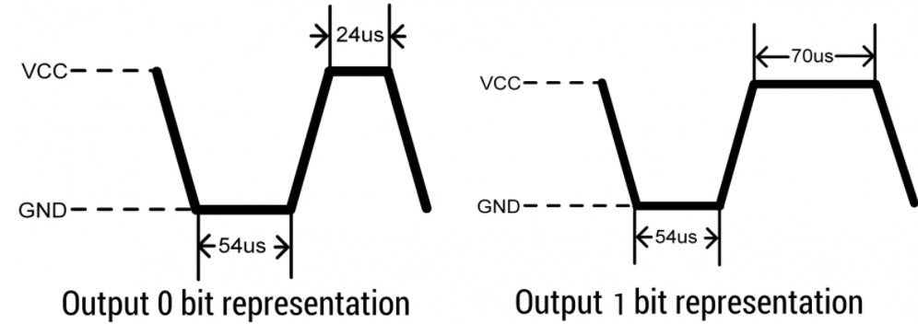
Data

Slide 33
DEMO

Slide 34
Thank You

